Slide 1




Problem Statement: Provide Insights to the Marketing Team in Food & Beverage Industry
Prepared by ,
Name: Dhruvi Padhiyar
Roll no:189
Enrollment no: 22002170220021
Batch: A6

Slide 2
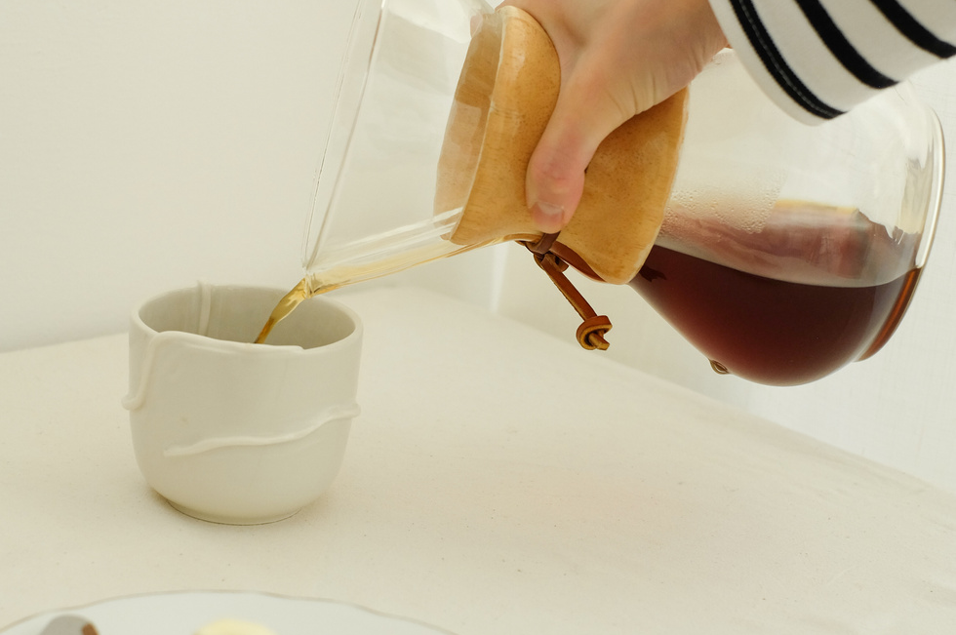


Idea that led to the concept:
As the food market is growing, an understanding of the market is needed
Functionality:
Insight generation
Project Outline

Slide 3


Jupyter notebook
Pandas linrary
Components used
Matplotlib library
Seaborn library

Slide 4

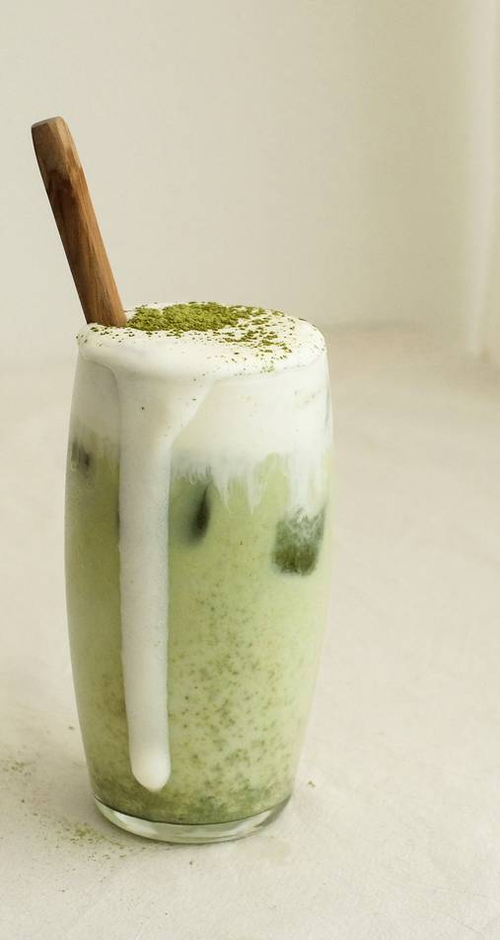
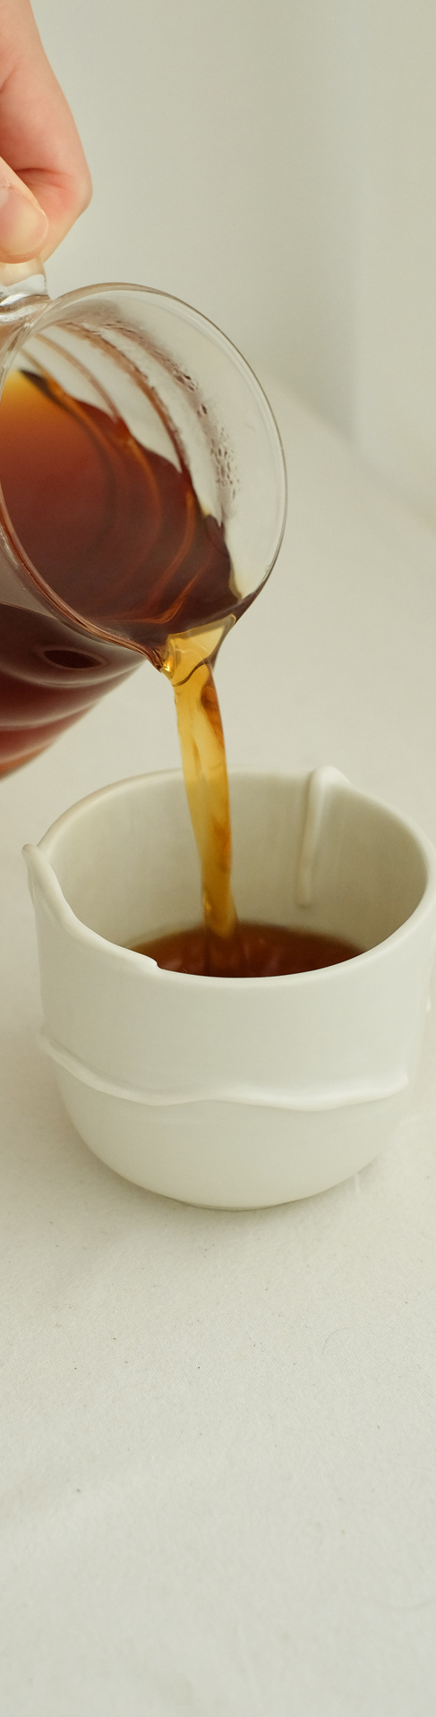


Future scope
Updating as per trend
Provide insights to other industries also

Slide 5

THANK YOU

